Slide 1
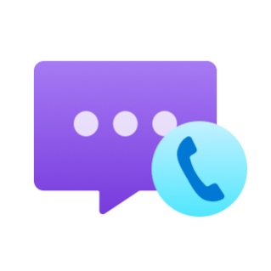

Send an SMS message with Azure Communication Services
Dan Wahlin
Cloud Developer Advocate
@DanWahlin

Slide 2
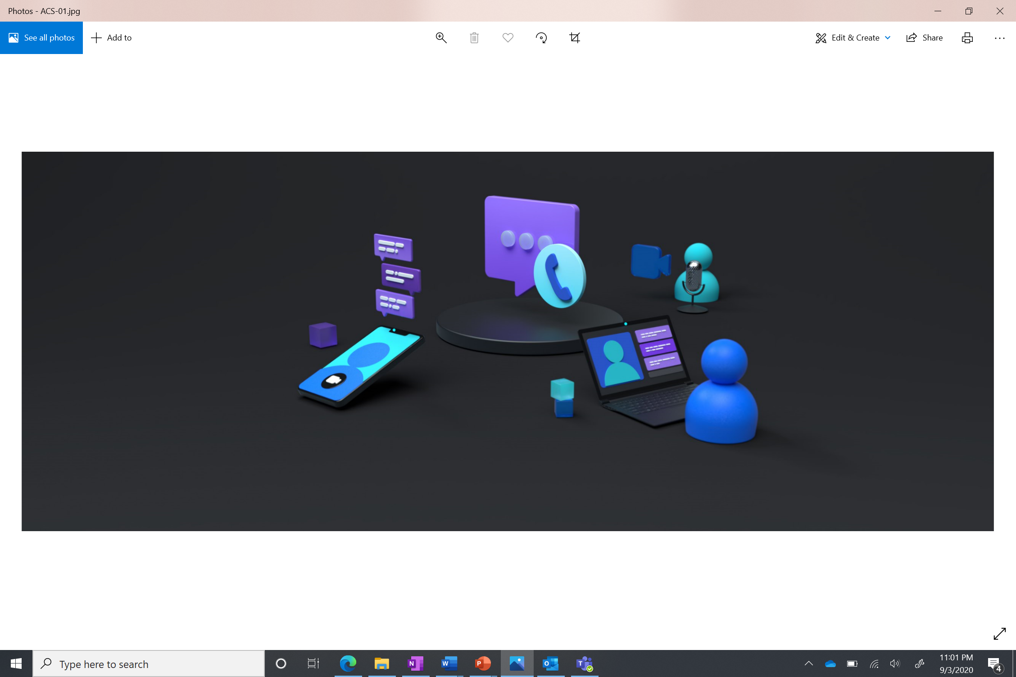
ACS Core Services​

Slide 3
Core Services
Voice and Video
Chat
SMS
Telephony
Network Traversal

Slide 4
ACS and SMS​

Slide 5
SMS Use Cases
Marketing and Promotions
Alerts
Customer Engagement
2 Factor Authentication

Slide 6
SMS Features

Slide 7
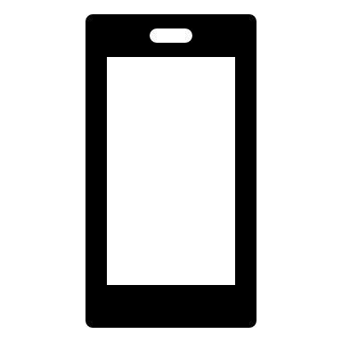

SMS Features
Simple Setup
High Velocity​
Two-way conversations
Analytics
Opt-out handling​
Notes:
Simple setup experience for adding SMS capability to your applications.​
High Velocity message support over toll free numbers for A2P (Application to Person) use cases in the United States.​
Two-way conversations to support scenarios like customer support, alerts, and appointment reminders.​
Analytics to track your usage patterns and customer engagement.​
Opt-Out handling support to automatically detect and respect opt-outs for toll-free numbers. Opt-outs for US toll-free numbers are mandated and enforced by US carriers.

Slide 8
Create ACS Service
Create a Toll Free Number
Add ACS Package to Project
Call Send()
Create SmsClient Object
Add Connection String to Project

Slide 9
Demo

Slide 10
Summary
Azure Communication Services provides support for audio/video/chat/SMS and more
Get started by creating an ACS resource in Azure.
Add a toll-free number.
Use the ACS connection string and number in your code.

Slide 11
Thanks!
https://aka.ms/acs-sms-quickstart
https://aka.ms/acs-ui-library
Dan Wahlin @DanWahlin

